Slide 1
Help Save a Life: The Deeper Meaning of Smoking Cessation
Jonathan B. Bricker, PhD & Kelly G. Wilson, PhD

Slide 2
Jonathan & Kelly

Slide 3
The Journey Ahead

Slide 4
The Journey Ahead
Smoking & Psychological Disorders: Consequences
The problem: We are not ready
A solution: Acceptance & Commitment Therapy, Bricker lab results
Motivating your client: “Hell no” & “No because…”
Show client HOW to quit: Craving acceptance & shame
Returning to values: What your life is about

Slide 5
Notes:
Jonathan B. Bricker, PhD
jbricker@u.washington.edu
1/17/2008
5

Slide 6
Comparative Causes of Annual Deaths in the United States
Number of Deaths (thousands)
AIDS Obesity Alcohol Motor Homicide Drug Suicide Smoking
Vehicle Induced
CDC, 2013
Notes:
Jonathan B. Bricker, PhD
jbricker@u.washington.edu
1/17/2008
6

Slide 7
Smoking by Diagnosis
41% Overall
Active
Lasser et al., 2000 JAMA
Notes:
Jonathan B. Bricker, PhD
jbricker@u.washington.edu
1/17/2008
7

Slide 8
Those with Psych Disorders
Smoking rates the same since 2004-2011: 25% vs. 19% to 16% decline for non-psych (Cook et al., 2014; JAMA)
Consume 31% of all cigarettes but are 20% of the population (CDC, 2013)
Die 8-18 years earlier than those without psych disorders (Chang et al 2011). Smoking is key reason why.
Notes:
Jonathan B. Bricker, PhD
jbricker@u.washington.edu
1/17/2008
8

Slide 9
The Problem
We are not ready to help!
Notes:
Jonathan B. Bricker, PhD
jbricker@u.washington.edu
1/17/2008
9

Slide 10
We are not trained
85% of clinical psychology doctoral programs offer NO smoking cessation training (Kleinfelder et al., 2012).
92% of clinical social work programs offer NO smoking cessation training (Kleinfelder et al., 2013).
50% of psychiatry residency programs offer NO smoking cessation training (Prochaska et al., 2006).
Notes:
Jonathan B. Bricker, PhD
jbricker@u.washington.edu
1/17/2008
10

Slide 11
Therapists Helping Smokers: 4 As
How many of you…
Ask clients if they smoke?
41-43%
Advise clients to quit?
25-45%
Assess willingness to quit?
10%
Assist on how to quit?
30%
Wendt (2005); Akpanudo (2009)

Slide 12
Benefits of Helping Clients Quit
Show you care about them (56%)
It would work…they actually quit (49%)
Improve their health (83%)
Help their psychological problems (17%)
What other benefits to you see?
Akpanudo (2009)

Slide 13
A Solution
Acceptance & Commitment Therapy: Bricker Lab Results
Notes:
Jonathan B. Bricker, PhD
jbricker@u.washington.edu
1/17/2008
13

Slide 14
ACT Research Program: The Wheel
Notes:
Jonathan B. Bricker, PhD
jbricker@u.washington.edu
1/17/2008
14

Slide 15
Trial 1: Telephone-Delivered ACT

Slide 16
6-Month Quit Outcome (30D PP)
CBT | ACT | OR (95% CI)
22% | 31% | 1.5 (0.7, 3.4)
Notes:
FU data retention was 67% with p=.18 on arm comparison.

Slide 17
6-Month Quit (30D PP) in Key Baseline Subgroups
Baseline Subgroup | CBT | ACT | OR (95% CI)
Pack-A-Day or More | 17% | 36% | 2.8 (0.6, 12.4)
Screened Depressed | 13% | 33% | 1.2 (1.0-1.6)
Avoidant of Cravings | 10% | 37% | 5.3 (1.3, 22.0)

Slide 18
Trial 2: Web-Delivered ACT

Slide 20
Quit Rate Comparison
3-Month Outcome | ACT | Smokefree | p-value
30-day quit rate | 23% | 10% | 0.050

Slide 21
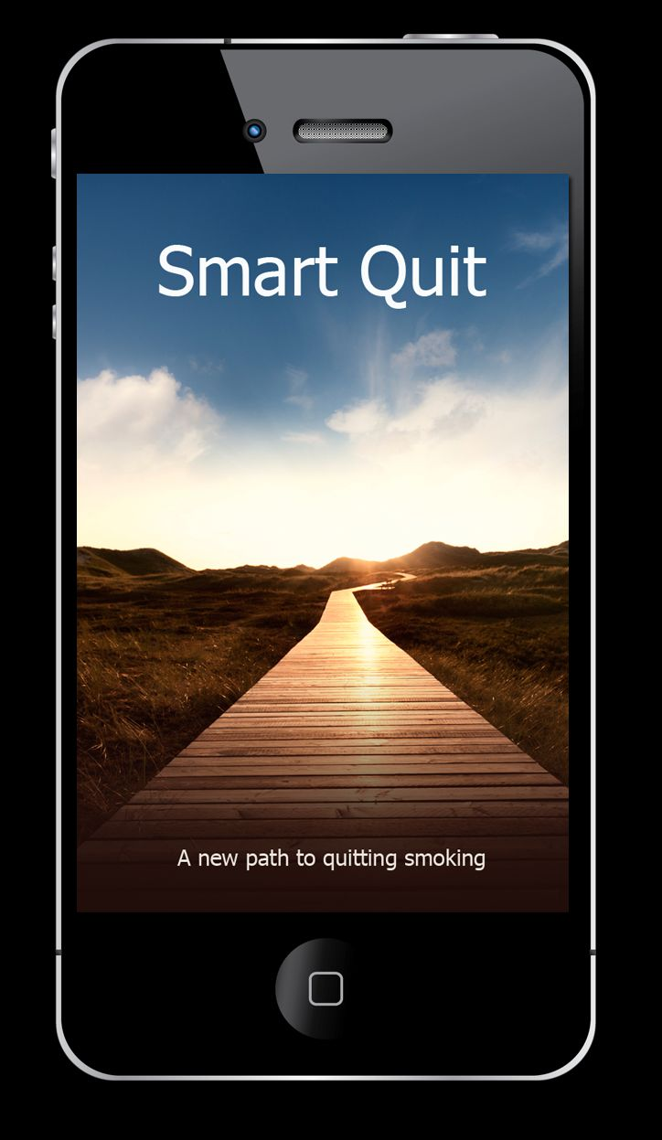
Trial 3: Smartphone-Delivered ACT

Slide 22
70-Day Follow-up: Quit (30D PP)
Quit Guide | Smart Quit | OR (95% CI)
8% | 13% | 2.7 (0.8, 10.3)
Notes:
FU data retention was 67% with p=.18 on arm comparison.

Slide 23
70-Day FU Quit (30D PP): Key Baseline Subgroups
Baseline Subgroup | Quit Guide | Smart Quit | OR (95% CI)
Pack-A-Day or More | 6% | 11% | 1.8 (0.1, 53.3)
Avoidance of Cravings | 8% | 15% | 2.9 (0.6, 20.7)

Slide 24
Summary on ACT for Smoking
Feasible intervention
50% to 300% higher preliminary quit rates
Notes:
Jonathan B. Bricker, PhD
jbricker@u.washington.edu
1/17/2008
24

Slide 25
Therapists: Ideal for Helping Clients Quit
Experts in behavior change
Know our clients well
Repeated contact and deeper trust

Slide 26
If there was a quit smoking intervention that…
Did not take more than 10 minutes per session and
Could be readily integrated into your main treatment…
Would you try it with a client?
Notes:
These are about 22-24% effective (6 month quit rates). These txs can be done within the main treatment session. They take no more than 10 minutes per session and repeatedly (5-10 sessions) because short and frequent sessions are more effective than long and less frequent sessions. Each module should take more than 10 minutes. Once you reach 10 minutes, stop where you are, give client an assignment, and in the next session continue where you left off.

Slide 27
Motivating clients to try
Client Scenario #1: “Hell no!”
Client Scenario #2: “No, not now because…”
Focus: modeling acceptance, values of self-care
Practice both scenarios
Debrief with all

Slide 28
Showing clients HOW to quit
Set a quit date
Together learn client’s “ABC”s
Focus on acceptance of urges
Model acceptance of shame and self-judgment

Slide 29
Set a Quit Date
Recommend clients set a date that is 14-30 days from today.
They can change their quit date. Its OK.
Use the next 14-30 days as a time to:
1) Gradually reduce smoking by agreed amount.
2) Learn skills to quit.
Notes:
In intense tx say that pharmacotherapy is designed to help clients manage withdrawal symptoms of cessation and/or urges to smoke. Common symptoms are irritability, tension, headaches, poor concentration, increased hunger, trouble sleeping
If clients want to supplement behavioral treatment with pharmacotherapy then its best they choose one or a combination of options in advance, as certain options like need to start about 4 weeks in advance of quitting to allow for gradual fading or time for the drugs to be effective by the time they quit. For example, buproprion is suited for treating co-morbid depression and takes about 4 weeks before it would be effective.
Women that NRT is somewhat less effective in women perhaps bc NRT is more effective in suppressing wd in men than women
Adolescents: Debatable whether NRT is effective or harmful
For brief treatment, just refer clients to their PCP for pharmacotherapy or see a local pharmacist for an OTC pharmacotherapy.

Slide 30
Learn Client’s ABCs
For each cigarette smoked, record…
A: Urge strength before puffing (0-10)
B: Notice how many puffs you take
C₁: Urge strength after puffing (0-10)
C₂: Observe what smoking does to the urge
Notes:
Options 1 and 2 should be used for intensive tx

Slide 31
Learn Client’s ABCs
Antecedent: Become aware of urges, notice urge level
Behavior: Smoking
Consequences: Notice urge level change
Notes:
The philosophy of the approach is to integrate current CBT technologies into the treatment of smoking cessation. These techniques can be integrated and applied alongside your work on co-morbid mental disorders.

Slide 32
Mediation: Acceptance of Cues
Acceptance Mediator | Percent of Quit Effect Explained | p-value
Thoughts | 68.7% | .001
Emotions | 73.0% | .001
Sensations (urges) | 76.0% | .001
Combined Scale | 80.0% | .001

Slide 33
Help client accept triggers, especially urges
The Willingness Questions
“On a scale of 0-10 (where 10 means highly willing), how willing am I to let this urge pass AND not smoke?”
“When an urge comes along, can I let it pass?”
Track each night how many times you let an urge pass.
Notes:
For adolescents, “If I don’t smoke with them, they will think I am weird.” To that, “Notice that you are just having the thought. You don’t have to listen to that.” Or restructure: “How do you know they will think you are weird?” “Would you think your friends were weird if they did not smoke once?” “Are there any times when your friends are not smoking?” So there can be some exceptions. You can decide not to smoke in that situation and it can be ok because it has been OK in the past.

Slide 34
The Five Senses
When you have a craving to smoke, notice one thing you..
See for 10 seconds,
Hear for 10 seconds,
Touch for 10 seconds,
Smell for 10 seconds, &
Taste for 10 seconds.
Notes:
For adolescents, “If I don’t smoke with them, they will think I am weird.” To that, “Notice that you are just having the thought. You don’t have to listen to that.” Or restructure: “How do you know they will think you are weird?” “Would you think your friends were weird if they did not smoke once?” “Are there any times when your friends are not smoking?” So there can be some exceptions. You can decide not to smoke in that situation and it can be ok because it has been OK in the past.

Slide 35
Showing clients HOW to quit
Client Scenario: “I quit….And then I relapsed.”
Focus: craving & shame acceptance
Practice this scenario with a partner
Debrief with all

